Slide 1
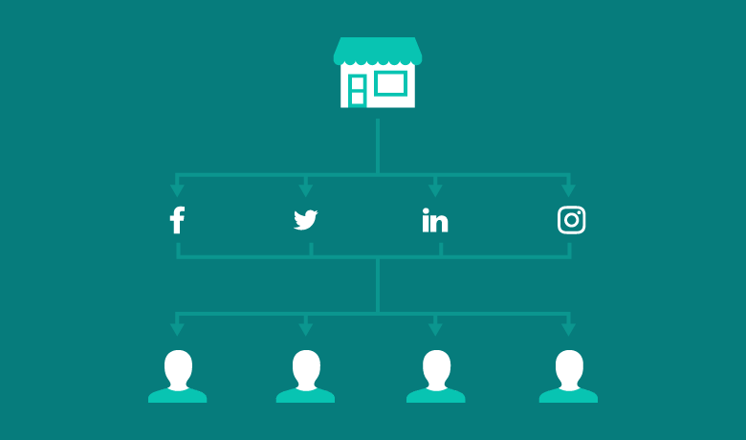
Social Media Algorithms
Tural Hajiyev (270010)

Slide 2
What is social media algorithm?
Social media algorithm is a way of sorting posts in a users’ feed based on relevancy instead of publish time.
Social networks prioritize which content a user sees in their feed first by the likelihood that they will actually want to see it.

Slide 3
Why Social Media algorithms exists
Algorithms exist to push brands to pay for social ads;
The theory is if they can’t reach their audience organically, brands will turn to ads instead, which earns money for the social networks
Before the switch to algorithms, most social media feeds displayed posts in reverse chronological order. The newest posts from accounts a user followed showed up first. This is still an option on Facebook and Twitter

Slide 4
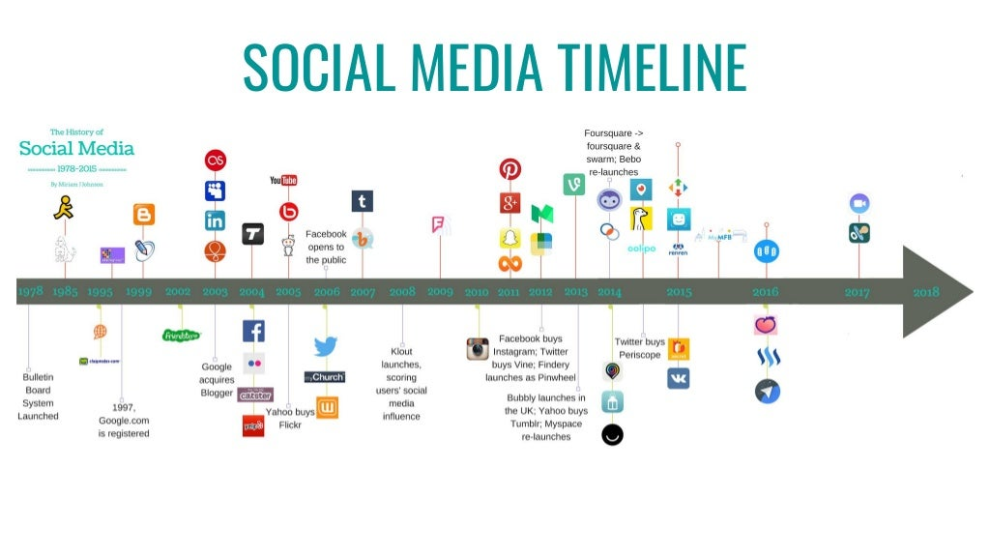
Social Media timeline

Slide 5
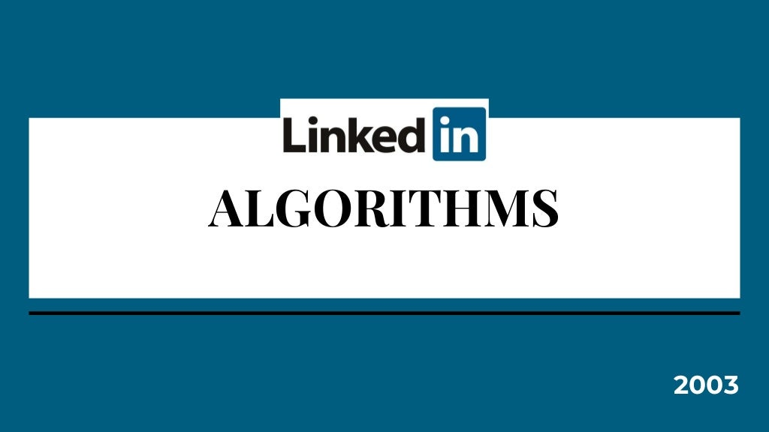

Slide 6
LinkedIn
ORIGINS
STATS
LinkedIn is a social network for professionals created by Reid Hoffman.
You can be a marketing exec at a major company, an entrepreneur, or even a college student looking to explore future career options, it is for anybody who is interested in taking their professional life more seriously by looking for new opportunities to grow their careers and to connect with other professionals
Out of 500 million LinkedIn users, 50% are active monthly.
40% use LinkedIn daily.
41% of millionaires use LinkedIn.
LinkedIn now has 3 million active job listing on the platform.

Slide 7
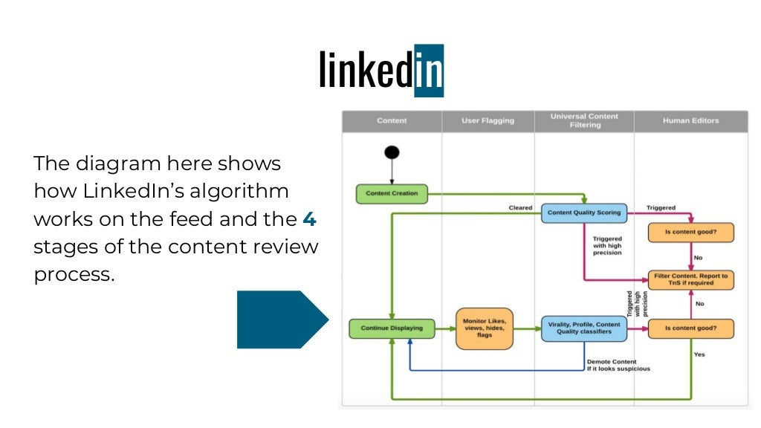
How LinkedIn works

Slide 8
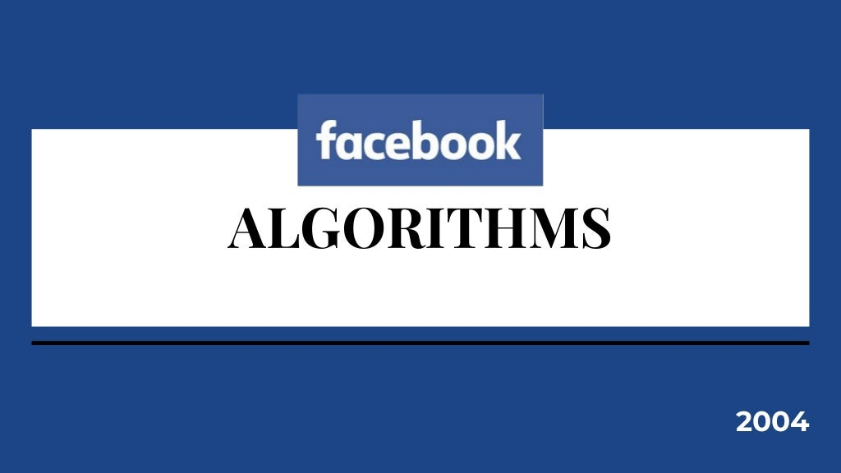

Slide 9
Facebook
ORIGINS
STATS
Facebook is a social networking site that makes it easy for you to connect and share with your family and friends online
Originally designed for college students, Facebook was created in 2004 by Mark Zuckerberg while he was enrolled at Harward University
By 2006, anyone over the age of 13 with a valid email address could join Facebook.
Today, Facebook is the world’s largest social network, with more than 2.2 billion users worldwide as of January 2018.

Slide 10
Main factors Facebook consider
Average time spent on content
What links are shared by another person over messenger
Replies, comments, and likes
Publisher/brand post shared by a friend
Content of shared posts

Slide 11
Main activities Facebook consider
Comments – Posts that generate a lot of meaningful comments and replies will move up in the news feed.
Shared – The second most important ranking signal. Interactions with posts shared publicly (by friends on a timeline) or privately (via the messenger) will cause those posts to perform better
Reactions – The third important signal for active engagement

Slide 12
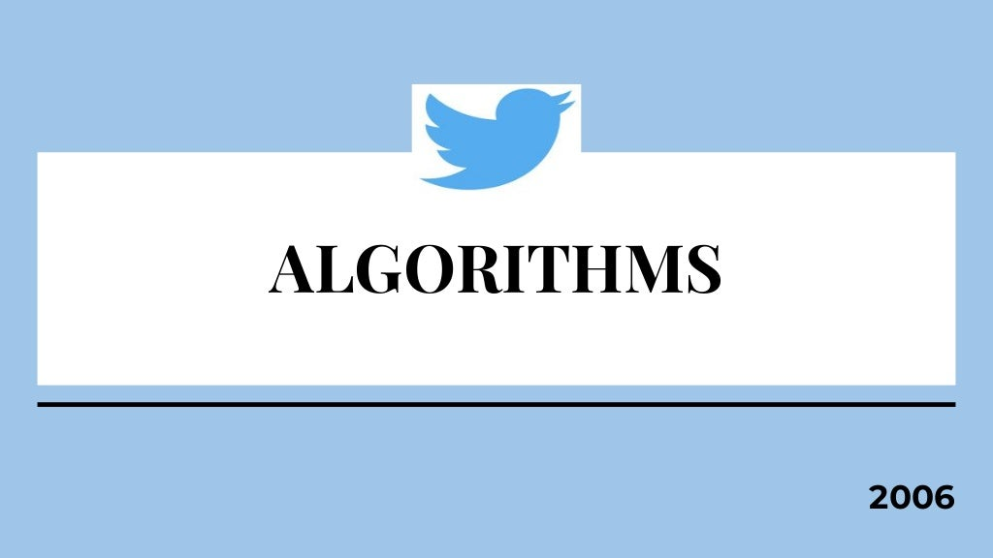

Slide 13
Twitter
ORIGINS
STATS
Twitter is an online news and social networking site where people communicate in short messages called tweets.
It is a form of microblogging (a combination of blogging & instant messaging)
In 2017, Twitter doubled the traditional 140-character limit to 280 characters.
As of the first quarter of 2018, Twitter averaged 336 million monthly active users

Slide 14
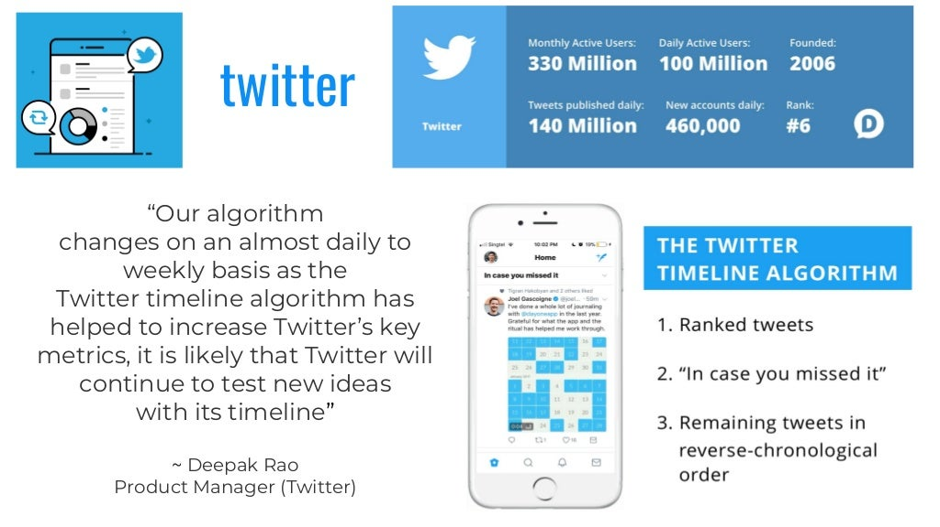

Slide 15
How to hack Twitter algorithms
Promote your tweets;
Reply to mentions;
Use hashtags strategically;
Re-use your top posts;
Experiment with posting times;
Consider running Twitter Ads;
Use Twitter Video;
Re-share your top tweets;

Slide 16
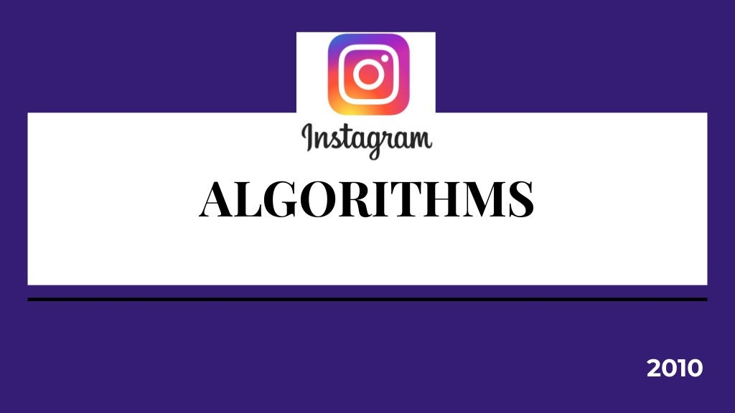

Slide 17
Instagram
ORIGINS
STATS
Instagram is a photo and video-sharing social networking service owned by Facebook, Inc.
When it first launched in 2010, users could only post photos through the app and add filters without any extra editing features.
As of October 2015, over 40 billion photos have been uploaded to the service.
Instagram (@instagram) is the most-followed user on Instagram (237 million followers)

Slide 18
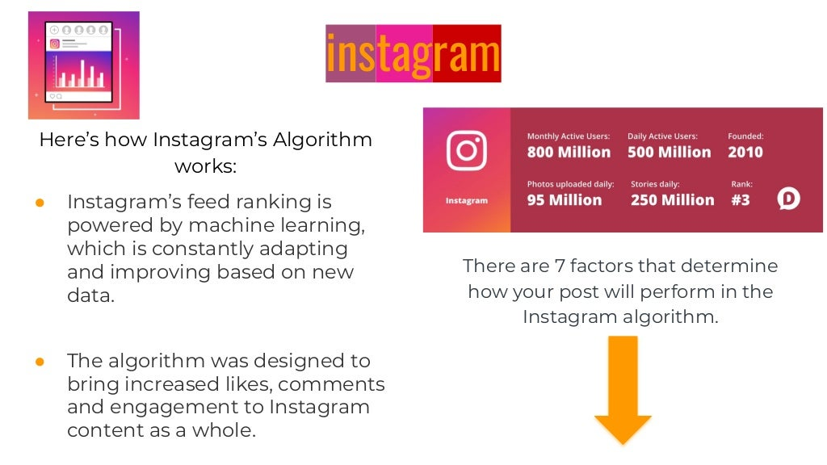
How Instagram works

Slide 19
Main factors about Instagram
How much engagement do your posts get?
How long has your content been viewed?
Who engages with your account the most?
What time of day do you post?
What type of content do you post?
Who searches for your account and how often?
How often your posts are shared via directly messages?

Slide 20
Thank you!

